Slide 1
UNIT 2: Instruction set
Unit 2-Instruction Sets : Characteristics, Types of operands, Types of operations, Assembly language, Addressing modes, Instruction format, Types of instruction, Instruction execution, Machine state and processor status, Structure of program, Introduction to RISC and CISC architecture.

Slide 2
UNIT 2: Instruction set
What is an Instruction and Instruction Set?
An Instruction is a command given to the computer to perform a specified operation on given data.
MOV A,B ADD A,D Register
MOV (1000), A ADD A,(8000) Memory
MOV A,(01) OUT (01), A I/O
ADD AL, #96 ADD A,#8575 Immediate Data
The instruction set of a microprocessor is the collection of the instructions that the microprocessor is designed to execute.
Microprocessor 8085 Set
Microprocessor 8086 Set
Microprocessor ARM Set

Slide 3
Instruction set-Characteristics
Characteristics:
1. Operation Code
2. Source Operand
3. Result (destination) Operand
4. Next Instruction address
5. Length of Instruction

Slide 4
Instruction set-operands
Source and result(Destination) Operands:
1. Memory
2. Register
3. Immediate ( Only Source Operand)
4. I/O Devices

Slide 5
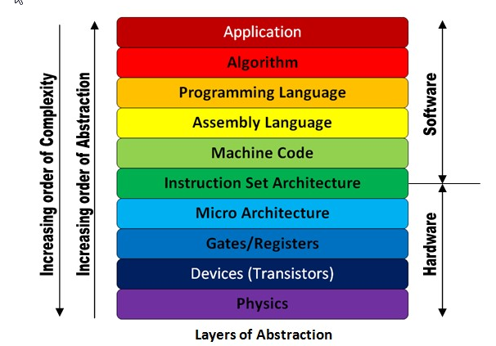
Instruction set Architecture(ISA)

Slide 6
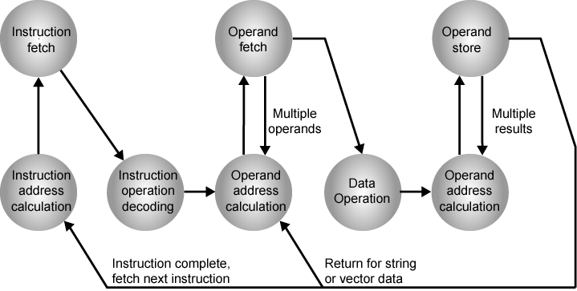
Instruction cycle state diagram

Slide 7
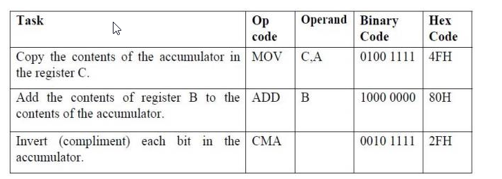
Instruction Format
Operation, Operand(s)

Slide 8
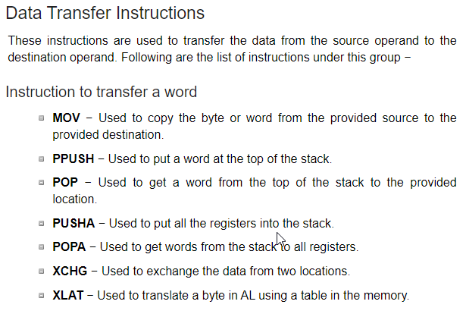
Data transfer Instructions

Slide 9
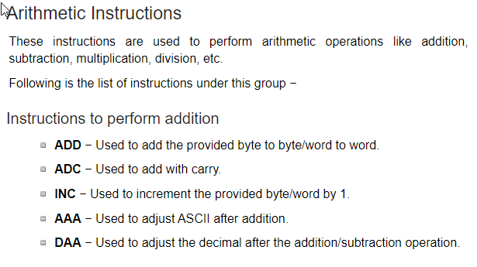
Arithmetic Instructions

Slide 10
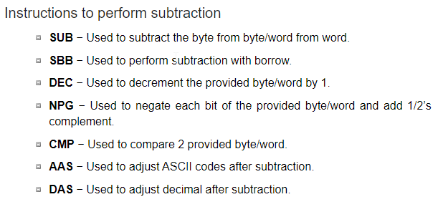
Arithmetic instrctions

Slide 11
Types of Operands
Types of Operations

Slide 12
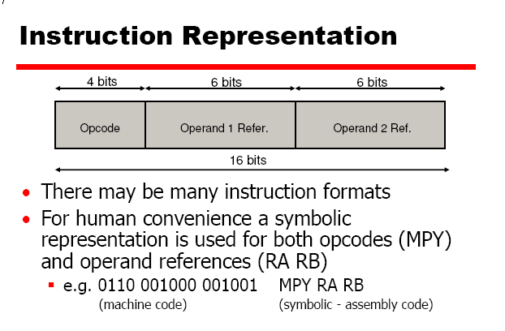

Slide 13
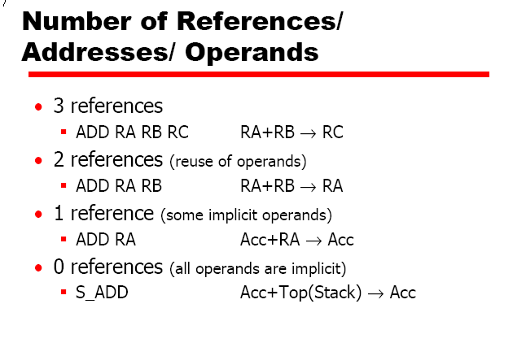

Slide 14
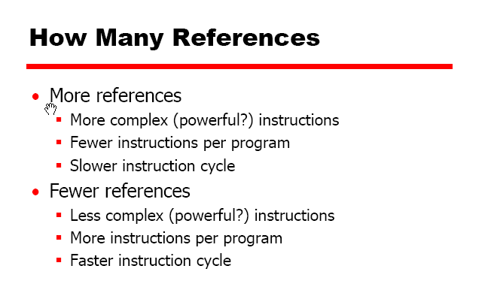

Slide 15
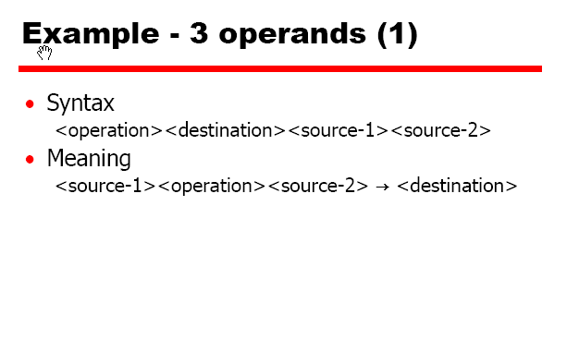

Slide 16
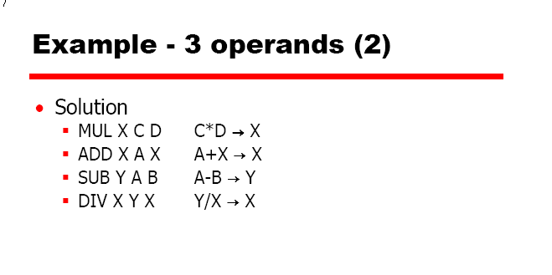

Slide 17
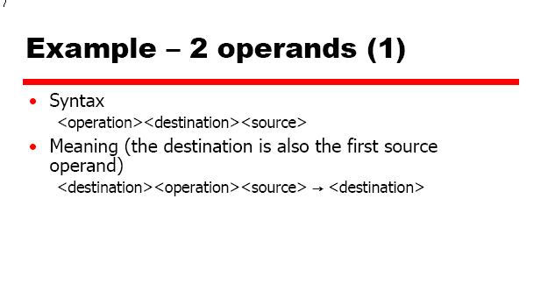

Slide 18
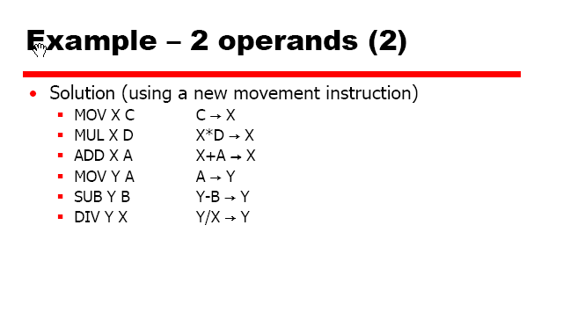

Slide 19
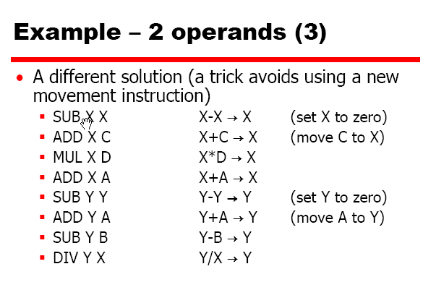

Slide 20
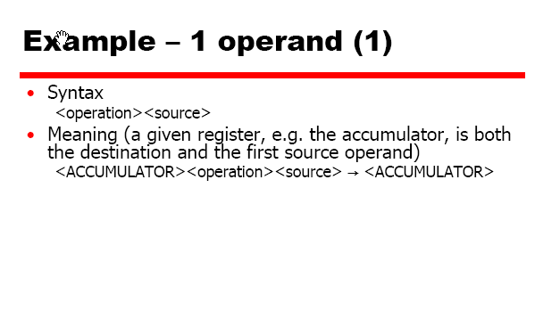

Slide 21
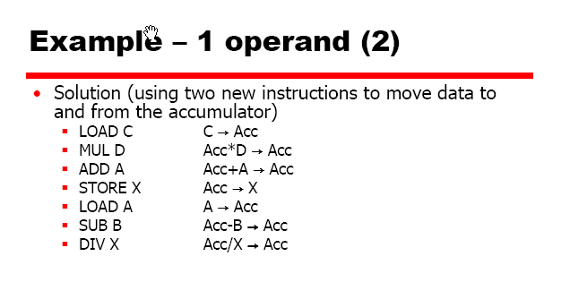

Slide 22
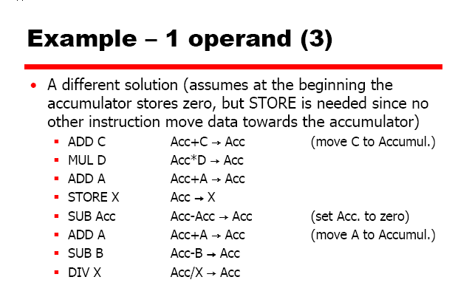

Slide 23
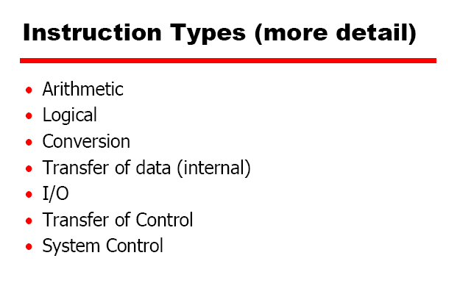
TYPES OF OPERATION

Slide 24
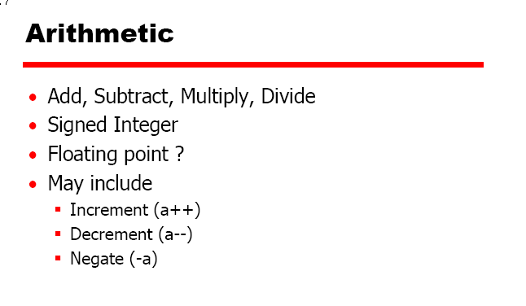

Slide 25
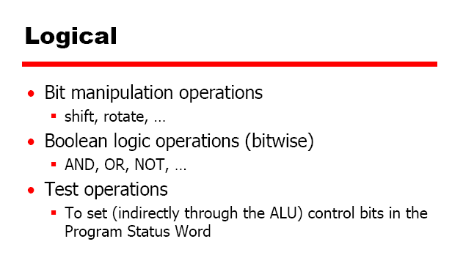

Slide 26


Slide 27
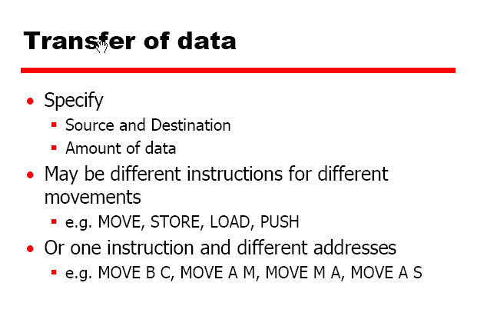

Slide 28
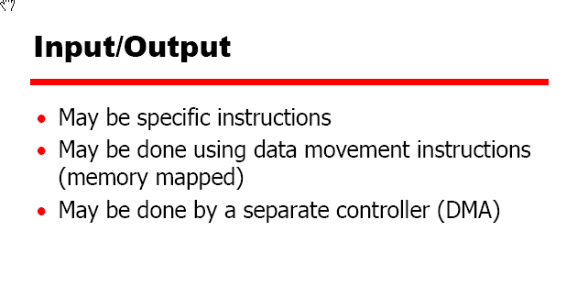

Slide 29
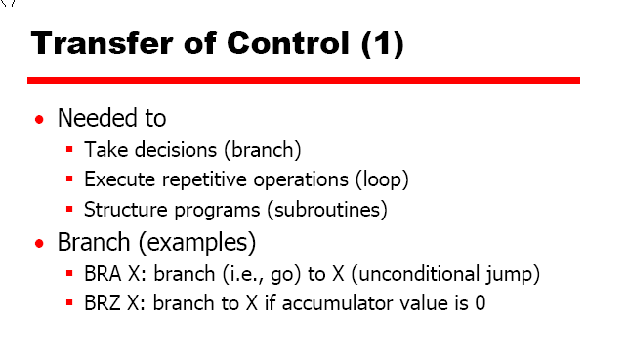

Slide 30
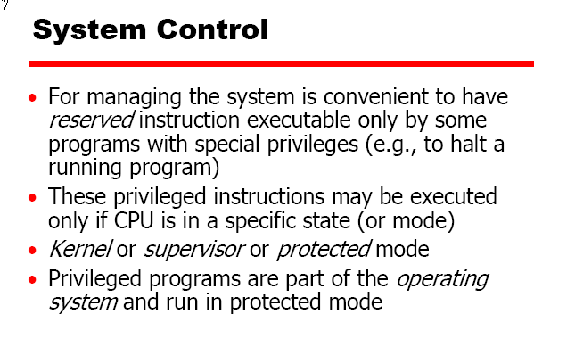

Slide 31


Slide 32
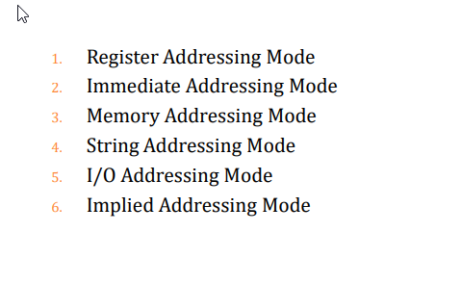

Slide 33
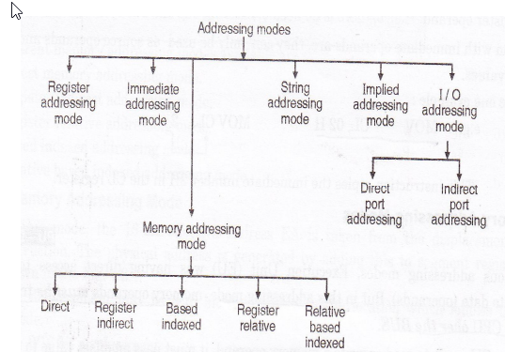

Slide 34

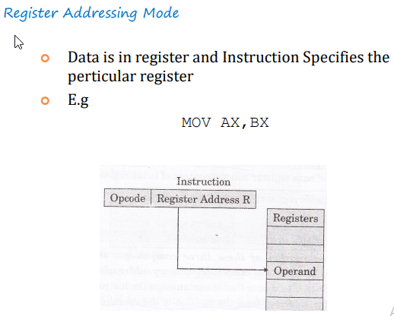

Slide 35

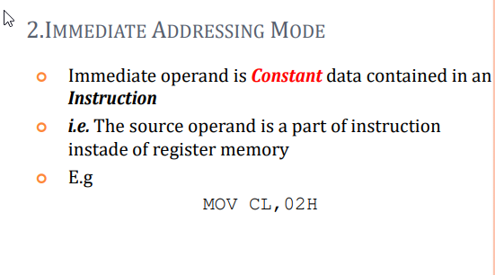

Slide 36

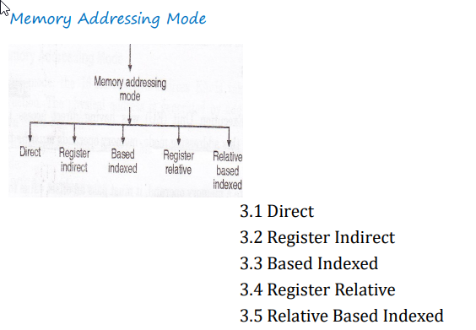

Slide 37
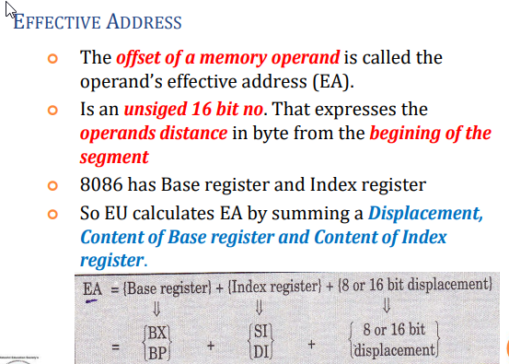
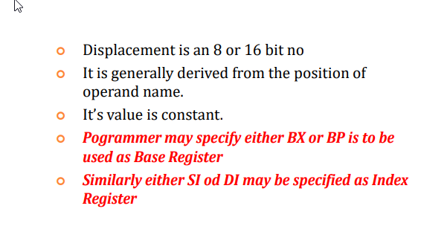

Slide 38

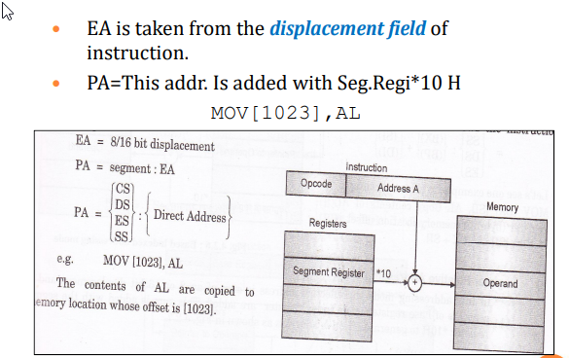

Slide 39

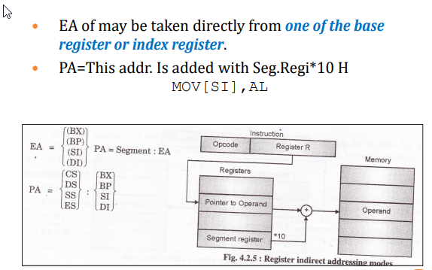

Slide 40
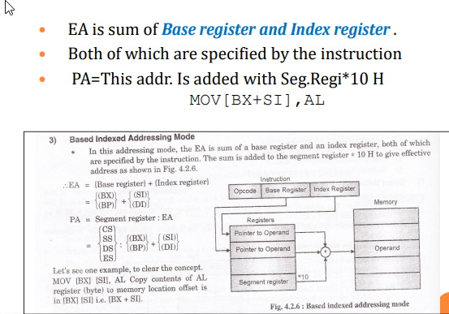


Slide 41
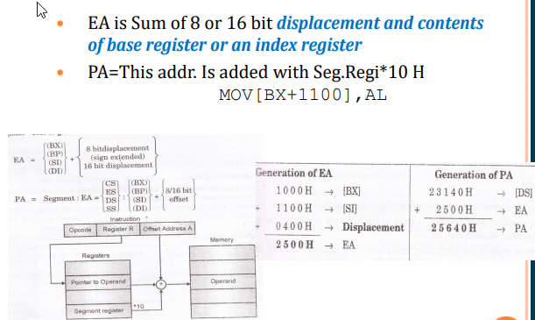

Slide 42

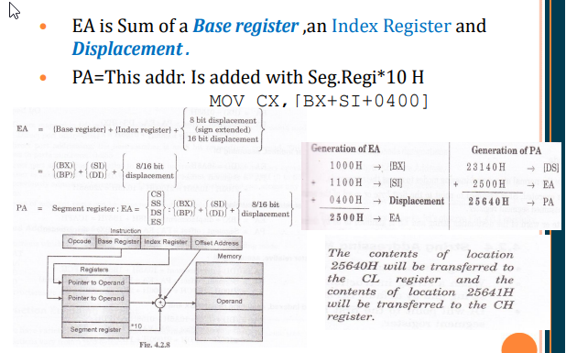

Slide 43
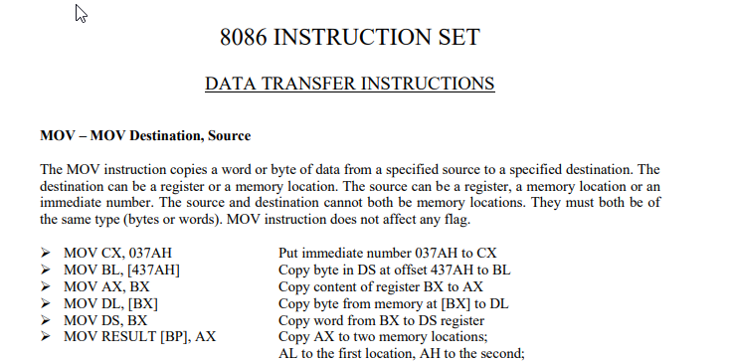

Slide 44
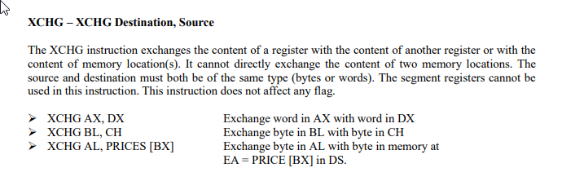

Slide 45
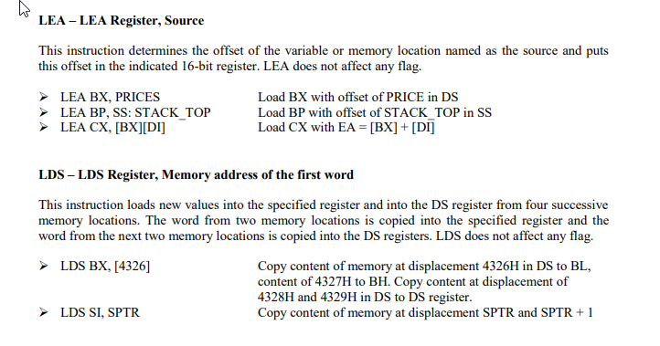

Slide 46
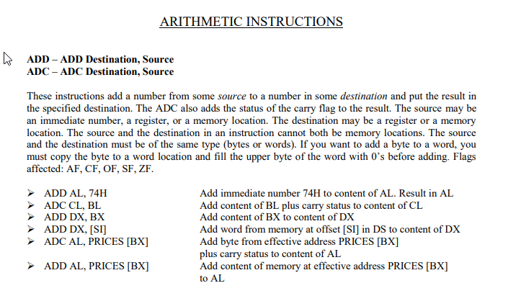

Slide 47
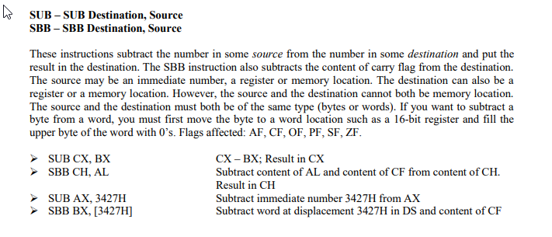

Slide 48
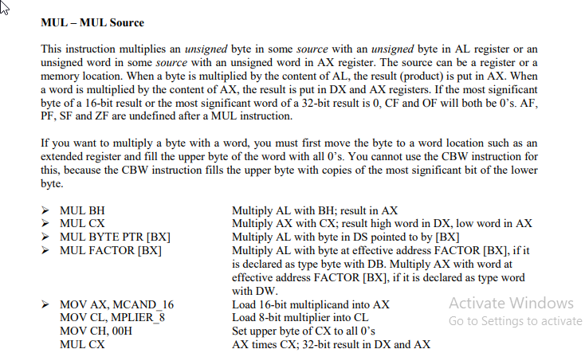

Slide 49
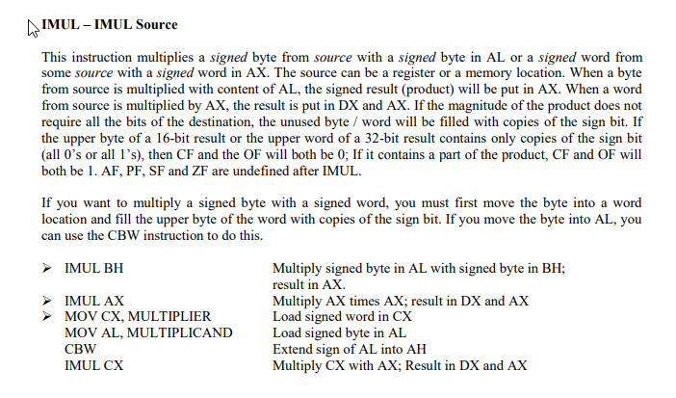

Slide 50
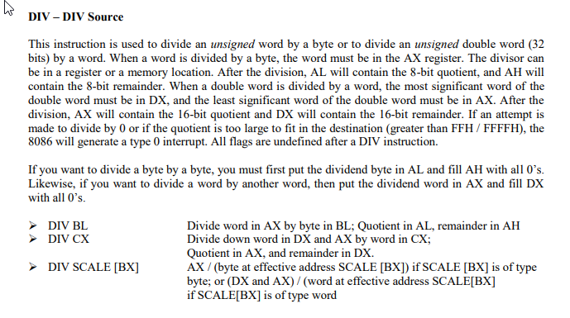


Slide 51
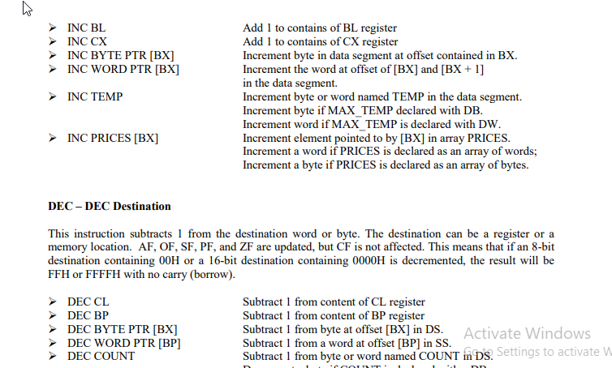

Slide 52
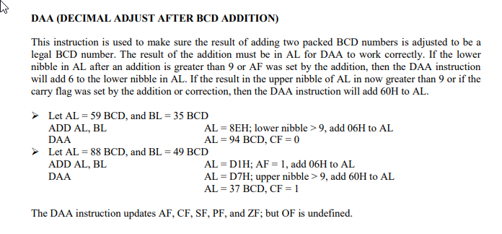

Slide 53
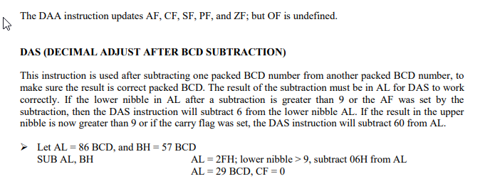
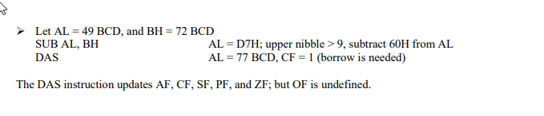

Slide 54
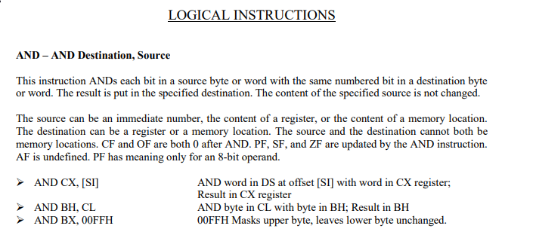

Slide 55
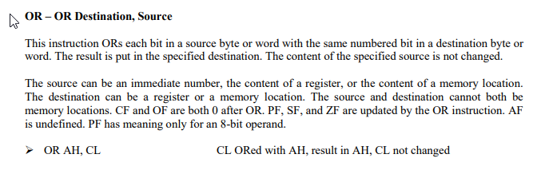


Slide 56


Slide 57


Slide 58



Slide 59


Slide 60



Slide 61



Slide 62



Slide 63


Slide 64



Slide 65



Slide 66
The CALL instruction in the 8086 microprocessor
The CALL instruction is used whenever we need to make a call to some procedure or a subprogram. Whenever a CALL is made, the following process takes place inside the microprocessor:
The address of the next instruction that exists in the caller program (after the program CALL instruction) is stored in the stack.
The instruction queue is emptied for accommodating the instructions of the procedure.
Then, the contents of the instruction pointer (IP) is changed with the address of the first instruction of the procedure.
The subsequent instructions of the procedure are stored in the instruction queue for execution.

Slide 67
The RET instruction in the 8086 microprocessor
The RET instruction stands for return. This instruction is used at the end of the procedures or the subprograms. This instruction transfers the execution to the caller program. Whenever the RET instruction is called, the following process takes place inside the microprocessor:
The address of the next instruction in the mainline program which was previously stored inside the stack is now again fetched and is placed inside the instruction pointer (IP).
The instruction queue will now again be filled with the subsequent instructions of the mainline program.

Slide 68


Slide 69

Point Harverd Von Neumann

Slide 70
Introduction to RISC and CISC architecture.
Reduced Instruction Set Architecture (RISC) – The main idea behind is to make hardware simpler by using an instruction set composed of a few basic steps for loading, evaluating, and storing operations just like a load command will load data, store command will store the data.
Complex Instruction Set Architecture (CISC) – The main idea is that a single instruction will do all loading, evaluating, and storing operations just like a multiplication command will do stuff like loading data, evaluating, and storing it, hence it’s complex.
RISC: Reduce the cycles per instruction at the cost of the number of instructions per program.
CISC: The CISC approach attempts to minimize the number of instructions per program but at the cost of increase in number of cycles per instruction.

Slide 71
Introduction to RISC and CISC architecture.
Characteristic of RISC –
Simpler instruction, hence simple instruction decoding.
Instruction comes undersize of one word.
Instruction takes a single clock cycle to get executed.
More number of general-purpose registers.
Simple Addressing Modes.
Less Data types.
Pipeline can be achieved.

Slide 72
Introduction to RISC and CISC architecture.
Characteristic of CISC –
Complex instruction, hence complex instruction decoding.
Instructions are larger than one-word size.
Instruction may take more than a single clock cycle to get executed.
Less number of general-purpose registers as operation get performed in memory itself.
Complex Addressing Modes.
More Data types.

Slide 73
Introduction to RISC and CISC architecture.
Example – Suppose we have to add two 8-bit number:
CISC approach: There will be a single command or instruction for this like ADD which will perform the task.
RISC approach: Here programmer will write the first load command to load data in registers then it will use a suitable operator and then it will store the result in the desired location.
So, add operation is divided into parts i.e. load, operate, store due to which RISC programs are longer and require more memory to get stored but require fewer transistors due to less complex command.

Slide 74
Introduction to RISC and CISC architecture.
RISC | CISC
Focus on software | Focus on hardware
Uses only Hardwired control unit | Uses both hardwired and micro programmed control unit
Transistors are used for more registers | Transistors are used for storing complex Instructions
Fixed sized instructions | Variable sized instructions
Can perform only Register to Register Arithmetic operations | Can perform REG to REG or REG to MEM or MEM to MEM
Requires more number of registers | Requires less number of registers
Code size is large | Code size is small
An instruction execute in a single clock cycle | Instruction takes more than one clock cycle
An instruction fit in one word | Instructions are larger than the size of one word

Slide 75
Introduction to RISC and CISC architecture.
Example of
RISC: ARM,AVR, ARC and the SPARC.
CISC: VAX, Motorola 68000 family, AMD and the Intel x86 CPUs.

Slide 76

Instruction Cycle
A program residing in the memory unit of a computer consists of a sequence of instructions. These instructions are executed by the processor by going through a cycle for each instruction.
In a basic computer, each instruction cycle consists of the following phases:
Fetch instruction from memory.
Decode the instruction.
Read the effective address from memory.
Execute the instruction.

Slide 77

Instruction Cycle:
Clock cycle: Each microprocessor needs a clock signal for its operation. The time period of this clock signal is called clock cycle. It is the smallest time unit for a microprocessor.
Machine cycle: The amount of time the microprocessor takes to perform a memory or I/O access. One machine cycle consists of several clock cycle.
Instruction cycle: The amount of time the microprocessor takes to fetch, decode and execute one Instruction. One Instruction cycle consists of several machine cycle

Slide 78

INSTRUCTION EXECUTION:
Six steps used to execute a single instruction.
Step 1: Fetch instruction.
Step 2: Decode instruction and Fetch Operands.
Step 3: Perform ALU operation.
Step 4: Access memory.
Step 5: Write back result to register file.
Step 6: Update the PC.

Slide 79
PROCESSOR STATUS:
The Processor Status Register is a hardware register which records the condition of the CPU as a result of arithmetic, logical or command operations. The purpose of the Processor Status Register is to hold information about the most recently performed ALU operation, control the enabling and disabling of interrupts and set the CPU operating mode.
Processor status word (PSW): A word that describes fully the condition of a processor at each instant. It indicates which classes of operations are allowed and which are forbidden, and the status of all interrupts associated with the processor. It will also contain the address of the instruction currently being executed. The PSW is held in a register known as the processor status register.

Slide 80

Assembly language program and structure:

